Slide 1
Shopping cart using string control
2016741050 정우제
2016741029 이명재
2016741057 이민호
2016741069 정현아

Slide 2
Index
1. Problem
2. Solution
3. Hardware
4. Progress

Slide 3
Problem

Slide 4

Problem
Inconvenience of climbing ramps
It's hard to carry on a ramp with luggage.

Slide 5


Problem
Occurrence of disturbance
Image processing in the field is uncertain due to the large amount of noise.

Slide 6
Solution

Slide 7

Solution
Reduce user's burden
Electric power can be used to lessen the power to load.

Slide 8

Solution
Use string to control cart
Use the strap to get information about distance and direction.
Through these information, user can operate cart.

Slide 9
Hardware

Slide 10


Hardware
Constant length

Slide 11
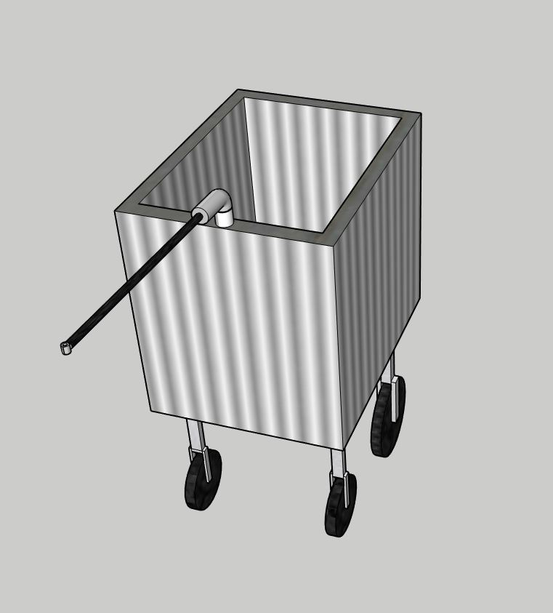
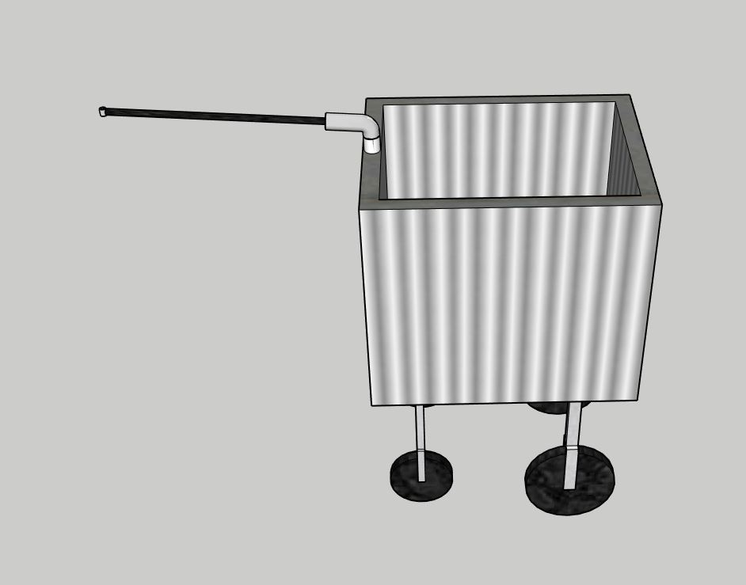
Hardware

Slide 12

Hardware
Mode 1
Mode 3
Mode 2

Slide 13
Progress

Slide 14
Progress
Hardware Concept
Order
Control motor & string
Programming hardware each part

Slide 15
Thank you!

